Slide 1



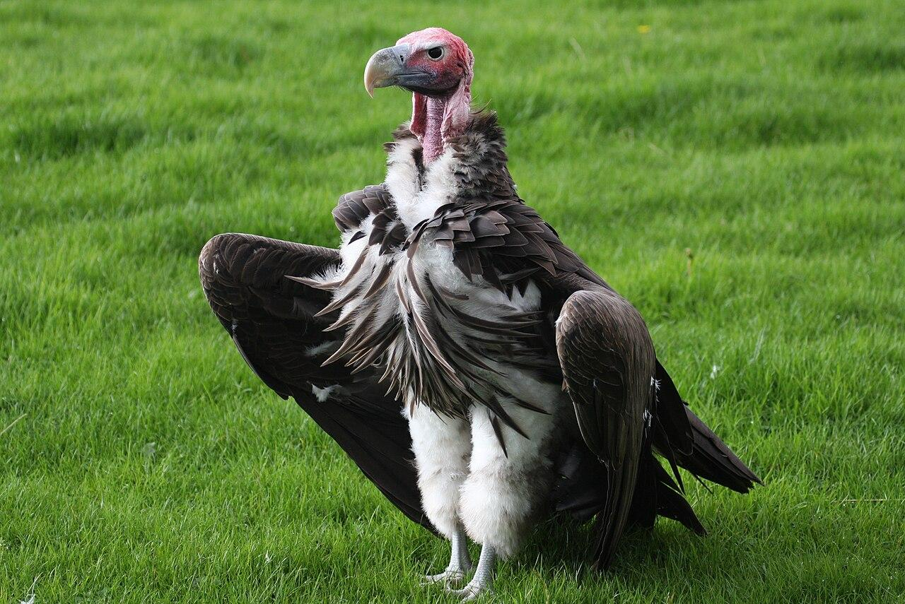
Four personas, one foundation.
WHO WE BUILD FOR
CANDIDATE · SENIOR
CANDIDATE · GRADUATE
CANDIDATE · EXPAT
HEADHUNTER · PILOT
Markus
Lena
Andrei
Sofia
Selective senior engineer
Recent graduate
Multilingual expat
Verified headhunter
— Few worthwhile roles per month
— Needs reasons, not noise
— Strong transferable skills
— Needs explained fit & gaps
— DE/EN CV & cover letter
— Controls who sees what
— Wants high-fit, available now
— Invitation-only, authorised JD
Personas are illustrative composites, still to be validated in 15 candidate and 5 headhunter interviews.
Notes:
Lena isn't alone. Markus: 60 alerts a week, no time for 59. Andrei: three languages, needs the real language requirement, has met fake recruiters. Sofia, a verified headhunter, wants available candidates who really fit her client's job, without trawling CV databases.

